Slide 1
Predictive control 11 Unbiased prediction with CARIMA models
Anthony Rossiter

Slide 2
Introduction
The previous video showed how one could form an unbiased prediction based on an independent or state space model.
This video looks at predictions from CARIMA models and what is required for these to be unbiased in the steady-state.

Slide 3
Unbiased prediction
As demonstrated in the previous video, by unbiased we mean that the predictions are exact in the steady-state.
past
If the future output predictions do not match the steady-state, they predictions are said to be biased.

Slide 4
CARIMA model
The most common transfer function model with MPC is the so called CARIMA model.
It is used because the uncertainty is included in a way that is a good representation of slowly varying disturbances that could have a non-zero steady-state.

Slide 5
Basic concepts of prediction with a CARIMA model
Discrete models are one-step ahead prediction models, that is, given data at sample ‘k’, one can determine data at sample ‘k+1’.

Slide 6
Predicting from the steady-state
In the steady-state one has the following.
Also, by definition:
And hence:

Slide 7
Summary
By definition using the CARIMA model gives predictions which are unbiased in the steady-state.
This is unsurprising given it is based on increments and thus is effectively a model based around any steady-state.
Interestingly, the CARIMA model does not estimate the effective disturbance explicitly and thus differs from the approach in the previous video.

Slide 8



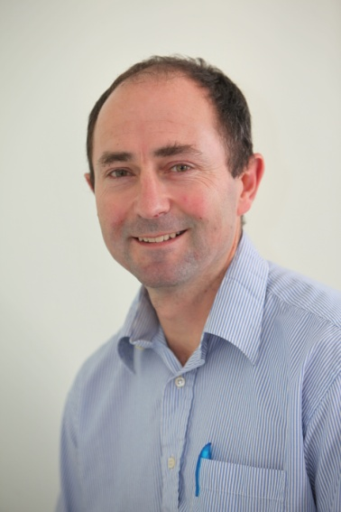
Anthony Rossiter
Department of Automatic Control and Systems Engineering
University of Sheffield
www.shef.ac.uk/acse
© 2014 University of Sheffield
This work is licensed under the Creative Commons Attribution 2.0 UK: England & Wales Licence. To view a copy of this licence, visit http://creativecommons.org/licenses/by/2.0/uk/ or send a letter to: Creative Commons, 171 Second Street, Suite 300, San Francisco, California 94105, USA.
It should be noted that some of the materials contained within this resource are subject to third party rights and any copyright notices must remain with these materials in the event of reuse or repurposing.
If there are third party images within the resource please do not remove or alter any of the copyright notices or website details shown below the image.
(Please list details of the third party rights contained within this work.
If you include your institutions logo on the cover please include reference to the fact that it is a trade mark and all copyright in that image is reserved.)

